Slide 1
German Immigration Patterns Prior to the Revolutionary War
My German forbearer, Ludwig Friderich Freysinger arrived in America in 1754.
He was my 5th great Grandfather.
What was the world he was experiencing?
Slide 1

Slide 2
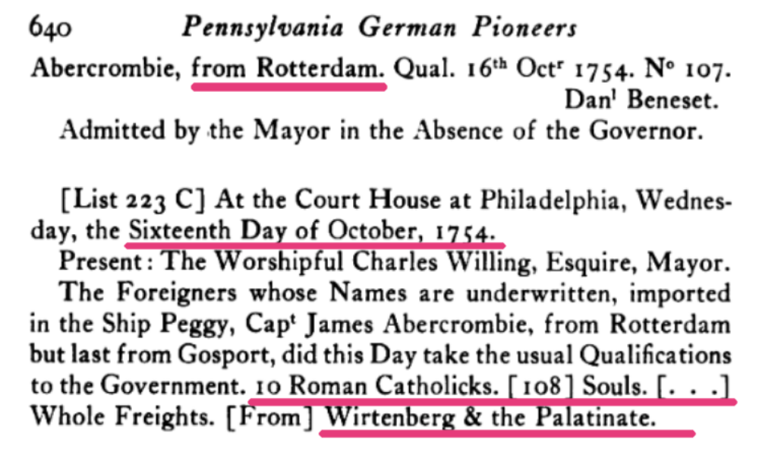
First Record we have of Ludwig
Slide 2

Slide 3
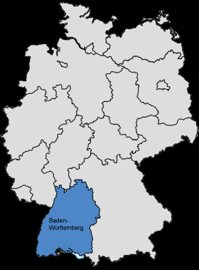
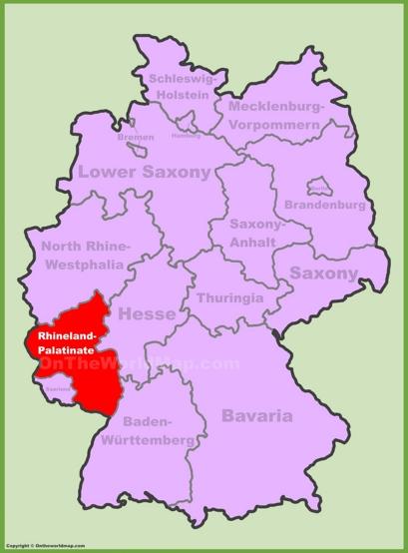
Württemberg, Palatinate
Slide 3

Slide 4
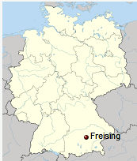
Where Family Legends Hold That Ludwig Came From:
The city of Freising is the overwhelming favorite
Bavaria (Bayern) a distant second.
One family group believes he was from the Black Forest
But no one has any firm evidence of where he came from or was born
Slide 4

Slide 5
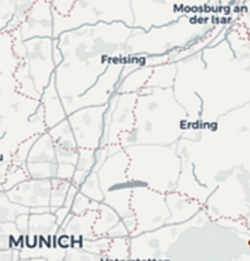
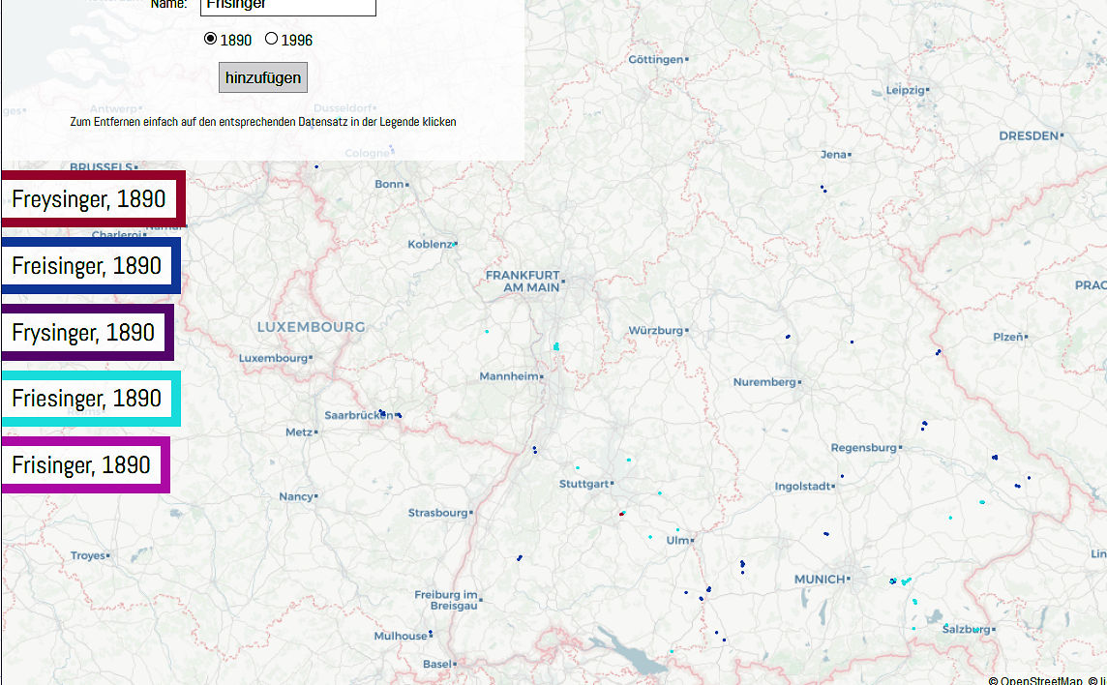
What was the Distribution of Freysingers in Germany
Slide 5

Slide 6
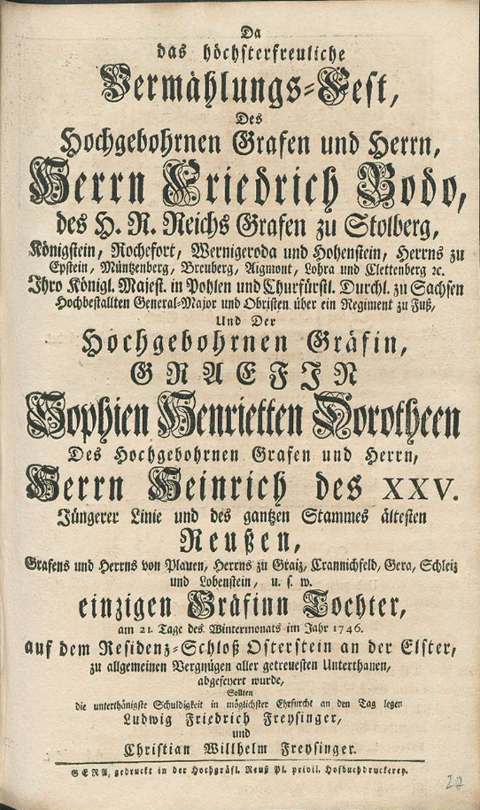
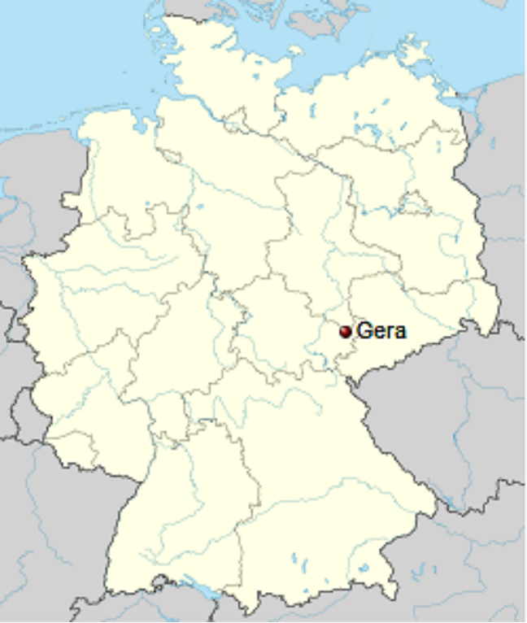
Doing an Internet Search I Found this:
A wedding invitation for nobles getting married in the city of Gera in 1746
(Ludwig immigrated 8 years later)
Slide 6

Slide 7
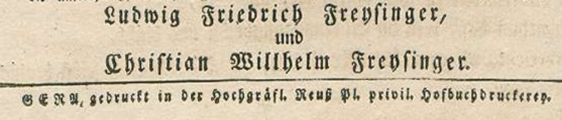
The original
The bottom 4 lines in German
Ludwig Friedrich Freysinger,
Und
Christian Willhelm Freysinger
GERA, gedruckt in der Hochgrafl. Reus Pl. Privil Hofbuchdruckerey
The bottom 4 lines in English
Ludwig Friedrich Freysinger,
and
Christian Willhelm Freysinger.
Printed in GERA hochgrafl. Reuben Privil. Pl. Hofbuchbru?lcrep
The wedding took place in 1746, Ludwig immigrated 8 years later.
Slide 7

Slide 8
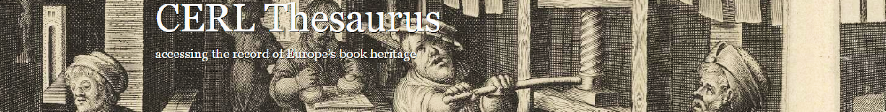
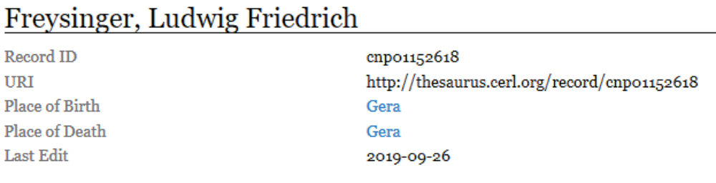
But then I Found This!
Slide 8
Slide 8

Slide 9
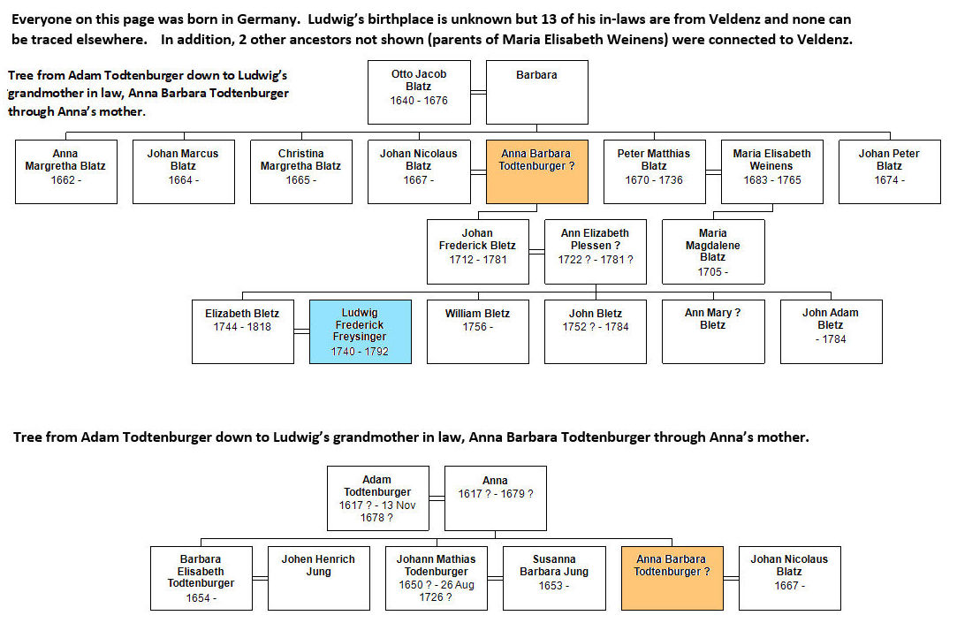
Ludwig’s in-Laws Were All From Veldenz Germany as far as I Could Tell
Slide 9

Slide 10
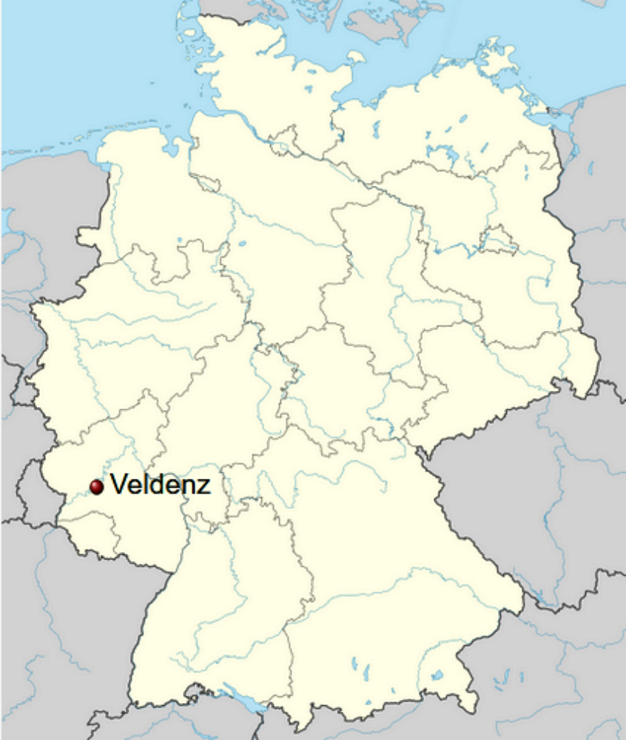
Where did Ludwig’s Wife Ancestors Come From?
She was born in Germany as was Ludwig. I have tracked down where 13 of her ancestors came from and they were all from Veldenz or the Veldenz region. This is on the Moselle river, a major tributary of the Rhine.
Slide 10

Slide 11
Timeline Connecting Ludwig With His Wife and Father to be
Year | Ludwig Frederick Freysinger | Age | Johan Frederick Bletz (Ludwig’s father in law to be) | Age | Elizabeth Bletz (Ludwig’s wife to be) | Age
About 1712 |  |  | Birth in Germany | 0
About 1740 | Birth in Germany | 0
1744 |  |  |  |  | Birth in Germany | 0
1748 |  |  | Immigrated from Germany to Philadelphia leaving the port of Rotterdam | 36 | Immigrated with her parents | 4
1753 |  |  | Living in Philadelphia | 41 | In Philadelphia with parents | 9
1754 | Immigrated from Germany to Philadelphia leaving the port of Rotterdam | 14 |  |  |  | 10
1754 | Living in Philadelphia | 14 | Johan could have helped Ludwig get established. | 42 |  | 10
?? | Ludwig and Elizabeth court. Note: Windsor, York County PA where Ludwig was living when his first child was born is only about 35 miles from Warwick, Lancaster County PA where his father in law as living 2 years after his first child was born. Courting someone 35 miles away would be a little awkward but if you already knew her father, would have been easy.
?? | Ludwig & Elizabeth marriage | ?? |  |  | Ludwig & Elizabeth marriage | ??
1766 | Birth of first child in Windsor, York County, PA | 26 |  | 54 |  | 22
1768 |  |  | Living Warwick, Lancaster County, Pennsylvania | 56
Ludwig and Elizabeth would not have been romanticly connected in Germany because Elizabeth was only 4 when she immigrated to America. However Elizabeth was almost certainly living with her parents in 1754 when Ludwig emigrated to Philadelphia. She was only 10 at the time but Ludwig may have known her father who had immigrated 8 years earlier and would be able to help the 14-year-old Ludwig out.
Slide 11

Slide 12
Timeline
1618 -1648 30 years war in Europe 8 million fatalities.
1672 Duke of York deeded lands to William Penn; Penn arrived in Pennsylvania
60 years later (1732) Thomas Penn (Son of William Penn) moved to Pennsylvania along with his brothers and substantially raised land prices and “taxes”
1740-1748 war of the Austrian Succession about 500,000 died in Europe
Oct. 16, 1754 Ludwig arrived in Philadelphia
1754 - 1763 French and Indian War (Britain takes over all of French territory in North America)
1763 Ludwig purchased land in Windsor Township York County PA
1764 and 1765 the hot topic was whether Pennsylvania should remain a property colony or become a royal colony
1765 Naturalization rates 10 times previous years
1765 Stamp Act passed by parliament
10 Years later (1775) Ludwig moved to Dover Township, York County PA
The next year was the start of the American Revolutionary War
Slide 12

Slide 13
Germany in the 1700’s
By the early 1700’s the population had rebounded from the devastation of the 30 years war and farmland was becoming scarce and fragmented
Rulers reluctant to let people leave Germany
Significant fees were charged by both the landowners and the state
Serfdom was dying but not dead
Each town could worship as they pleased but within a town there was intolerance
Slide 13

Slide 14
Where They Immigrated TO and WHY:
85% went to Eastern Europe
15% went to British North America
Advantages:
Shorter journey
Easy access if you lived near a river that flowed to the Black Sea such as the Danube or its tributaries
Religious freedom (No discrimination against Roman Catholics)
No danger of Indian attacks
Advantages:
Easy access if you lived near a river that flowed to the North Sea such as the Rhine or its tributaries
Minimal government interference
Very cheap land
Slide 14

Slide 15
German Immigration Prior to the Revolutionary War
1st wave 1683 to 1709 there was religious persecution of radical pietist groups, nearly continuous warfare in southwest Germany total number of immigrants small
2nd wave 1709-1714 In 1709 there was an agricultural disaster in Europe
3rd Wave 1717-1775 Population was expanding faster than could be absorbed in Germany. Farms getting smaller and broken up. This was the main immigration wave.
Slide 15

Slide 16
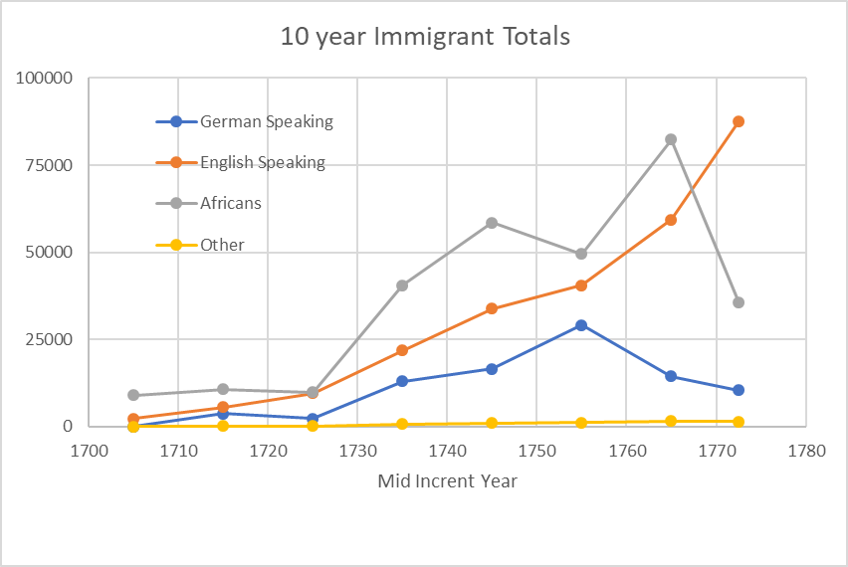
Immigration Trends to British N. America
Slide 16

Slide 17
What parts of Germany did immigrants to British North America come from?
Slide 17

Slide 18
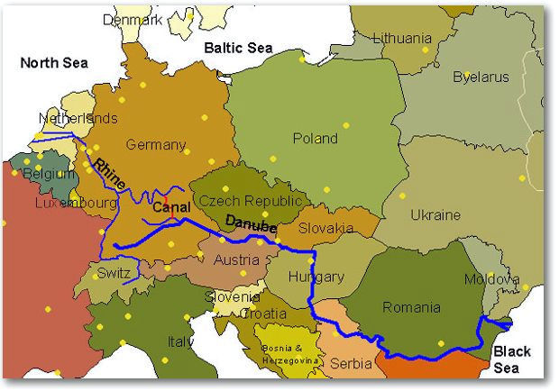
The Danube and the Rhine
Slide 18

Slide 19
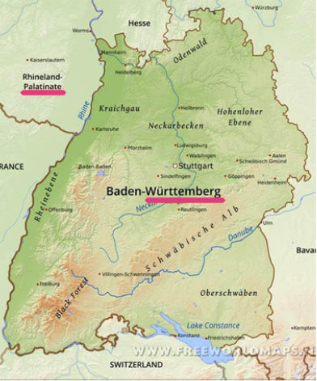
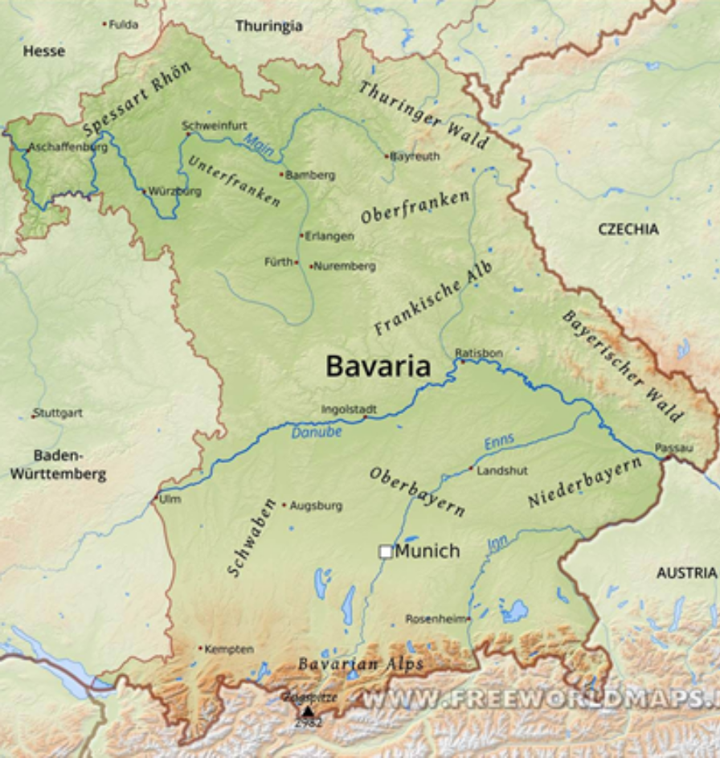
Palatinate, Württemberg & Bavaria
Slide 19

Slide 20
Conclusion:
It is very unlikely that Ludwig Friderich Freysinger immigrated from the area around the town of Freising
and very likely he came from the area around Württemberg or the Palatinate where most Germans came from
Slide 20

Slide 21
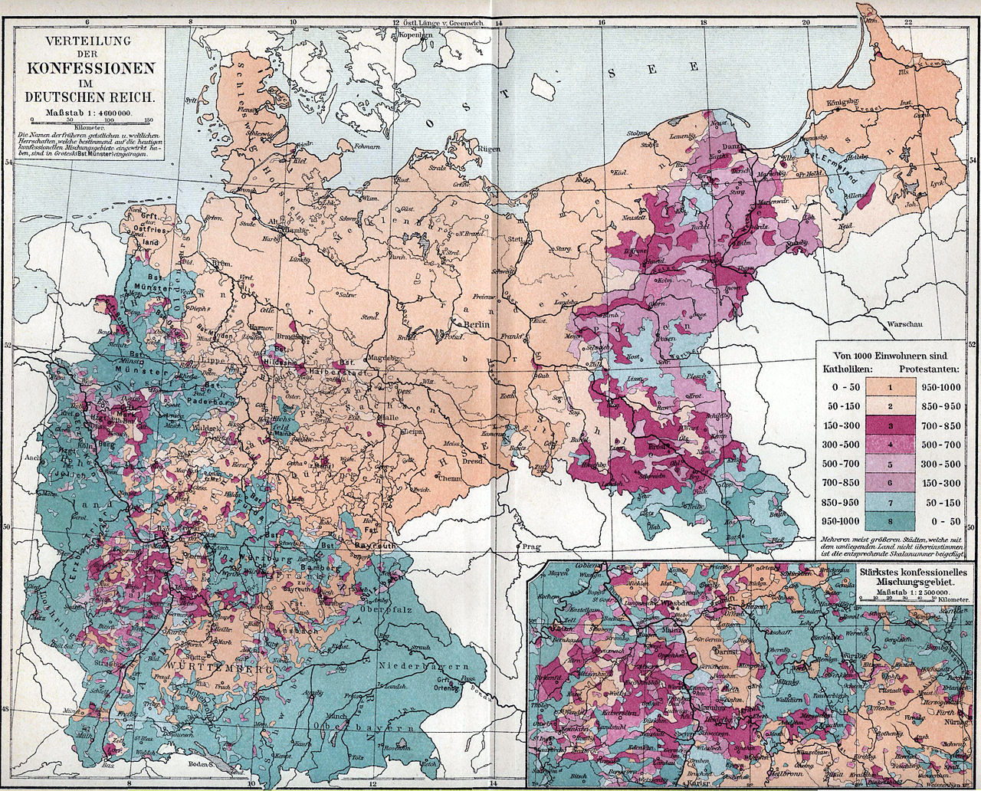
What About Northern Germany?
The area is primarily Protestant according to this 1895 map.
There are plenty of rivers flowing north.
Not as convenient to Rotterdam but not terribly remote.
I have no idea, possibly the inheritance customs where different so the farms were not as fragmented. Possibly better governance. Ideas?
Slide 21

Slide 22
Pennsylvania Germans 1776
Lutheran 50%
Evangelical Reformed Church which became the German Reformed Church then Reformed Church of the United States (Not part of the Dutch Reformed Church) 47%
Roman Catholics 3% of the total
The church was very important for the new immigrants because it formed the community that the village had back home
Slide 22

Slide 23
Population of major American cities 1750
Philadelphia 25,000
New York City 15,000
Boston 15,000
Port of Baltimore 7,000
Charleston, SC Center of the slave trade
(In 1770 population 11,000, ½ slaves)
Slide 23

Slide 24
Upon Arrival
Some had the money to pay for their passage
Others hoped to find a family or friends who would loan them the money
The final fallback was to be an indentured servant (redemptioners) for a period typically of 5 years
Settled in communities of like-minded immigrants
Slide 24

Slide 25
Germans Who Were Naturalized in 1740 by Township
63%
73%
72%
49%
Only Germans in Philadelphia and a few other scattered areas mixed significantly with other ethnic groups.
Slide 25

Slide 26
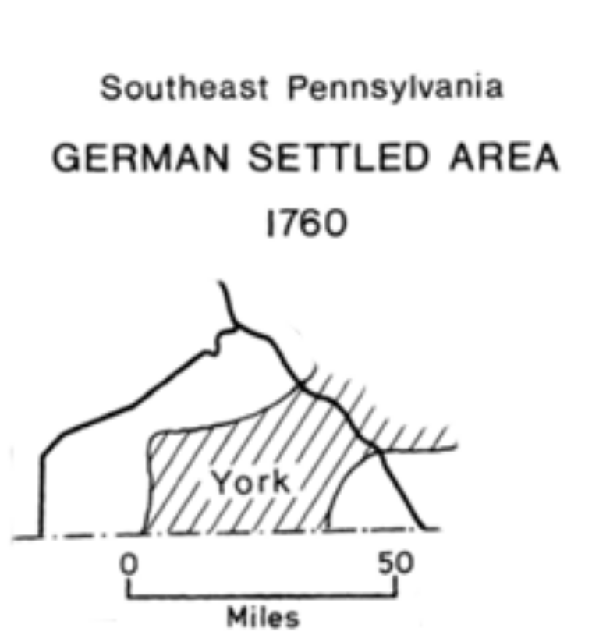
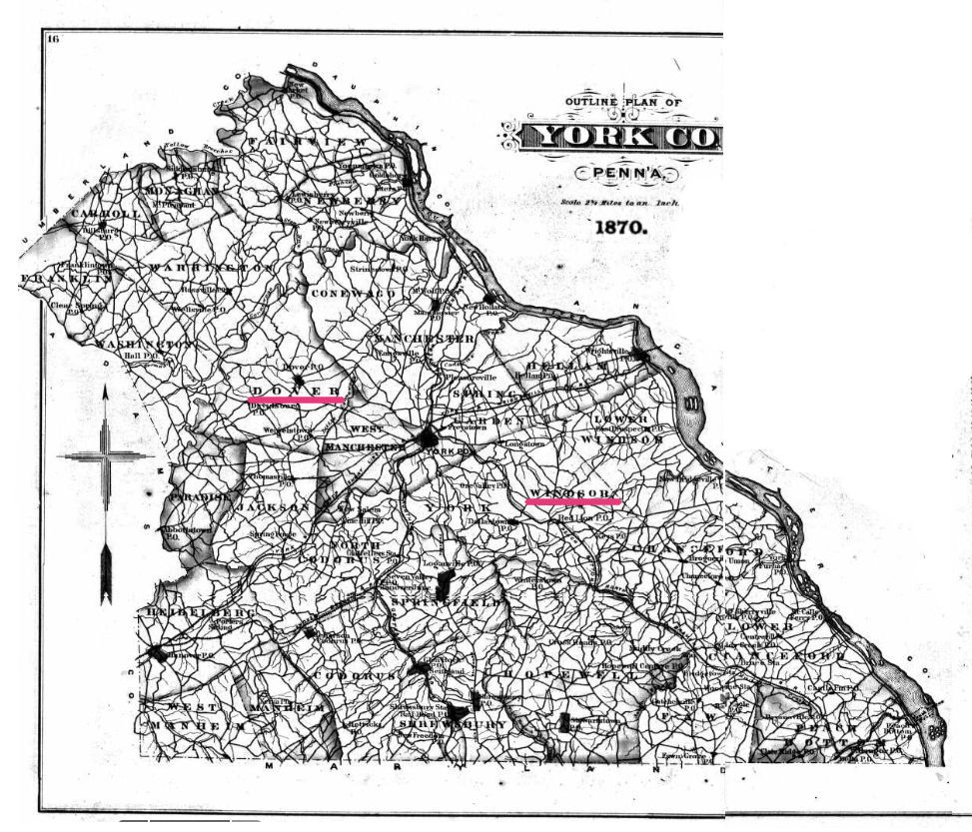
Closeup of Where Ludwig Lived, York County
Slide 26

Slide 27
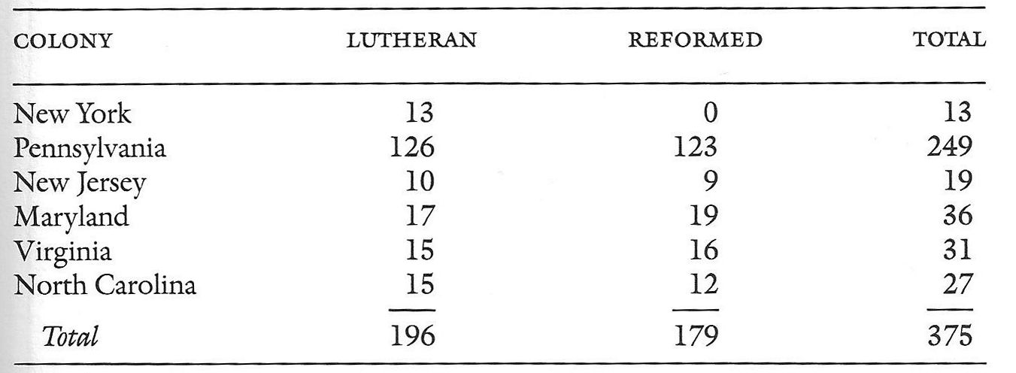
Churches in Greater Pennsylvania 1776
In addition there were about 7 Roman Catholic churches which were mainly German
Slide 27

Slide 28
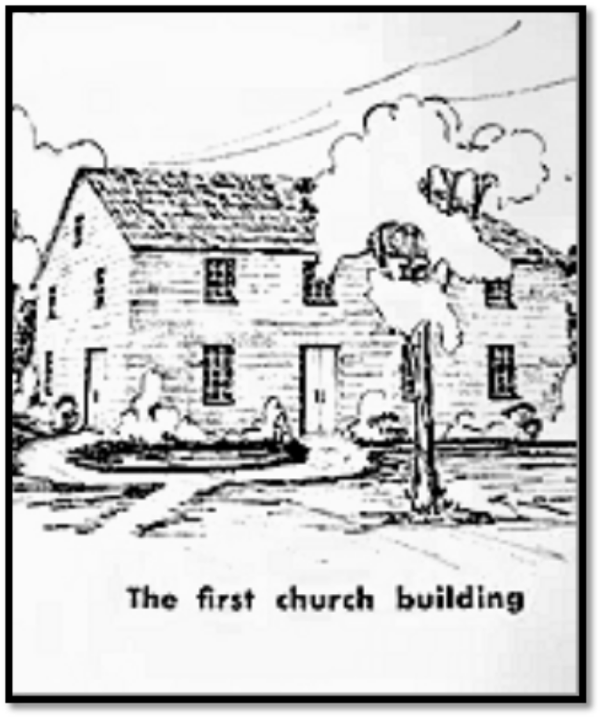
Quickel Lutheran Church
My Ludwig’s church was Quickel Lutheran Church in the hamlet of Zion’s View 7 miles North North West of York PA. It was founded in 1763, 9 years after he immigrated and the year he purchased land in York County Windsor township.
It is about 6 miles from the Current Dover Township where Ludwig moved to in 1775.
Slide 28

Slide 29
Radical Pietist Groups
Broke off from the Lutherans
Believed in:
  Religion of the heart not the head
  Personal experience of salvation
  Bible study, prayer and fasting
  No hierarchy
Some of these groups were:
  Evangelical Covenant Church
  Moravians
  Amish
  Mennonite
Slide 29

Slide 30
From a 1750’s Article About a Newcomer’s Observation
What German newcomers liked:
  Freedom of movement (without fines or fees)
  Generous and helpful inhabitants
  No tithes
  No forced labor
  No Feudal dues
What they did not like:
  Everything is so far apart, Churches, doctors, veterinarians, schools
  Shortage of preachers
  High price of land
Slide 30

Slide 31
Property Colony or Crown Colony
The Hot Issue in 1764-1765
Property Colony
  All the land initially belonged to the ruler, the Penn family and was administered by them
Crown Colony
  Governed by officials appointed by the King
Hot political issues
  The Penn family wanted more money for the sale of land, the Germans were generally not paying anything
  Germans wanted protection from Indian attack, the Quakers wanted coexistence
  Germans wanted legal safeguards to keep immigrants from being exploited
  The Quakers were now against Penn
  Need for currency to buy land
  Legal title to their land
  Inheritance rules (escheat)
Note: Stamp act passed in 1765, Boston Tea Party 1773
Slide 31

Slide 32
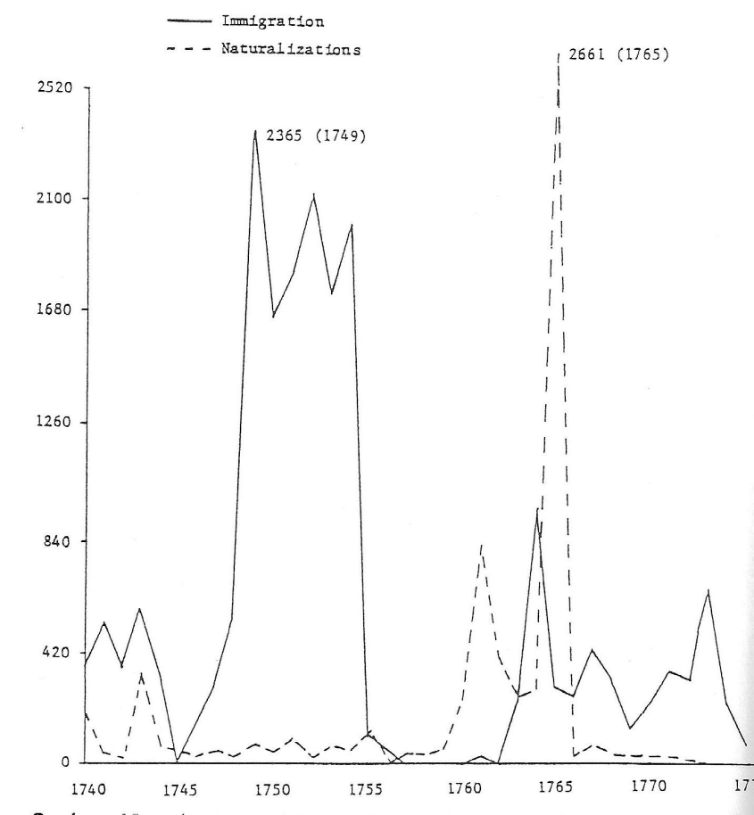
Male Immigration and Naturalization Rates in Pennsylvania
1765 Parliament passed a law making naturalization much easier
1765 Stamp act passed
About 1/3 of the German immigrants were naturalized
Remember people from England, Scotland, Wales and Ireland did not need to be naturalized
1754 - 1763 French and Indian War
Slide 32

Slide 33
Late Colonial Period Through the Revolutionary War
Immigration dwindled
German language press flowered
Ministers and priests mostly locally trained
Churches prospered
Dependence on Europe mostly broken
Before the 19th century they rarely married outside their ethnic group
Connections with extended family, home village and church often critical factors in their success
Increased involvement in politics
Slide 33

Slide 34
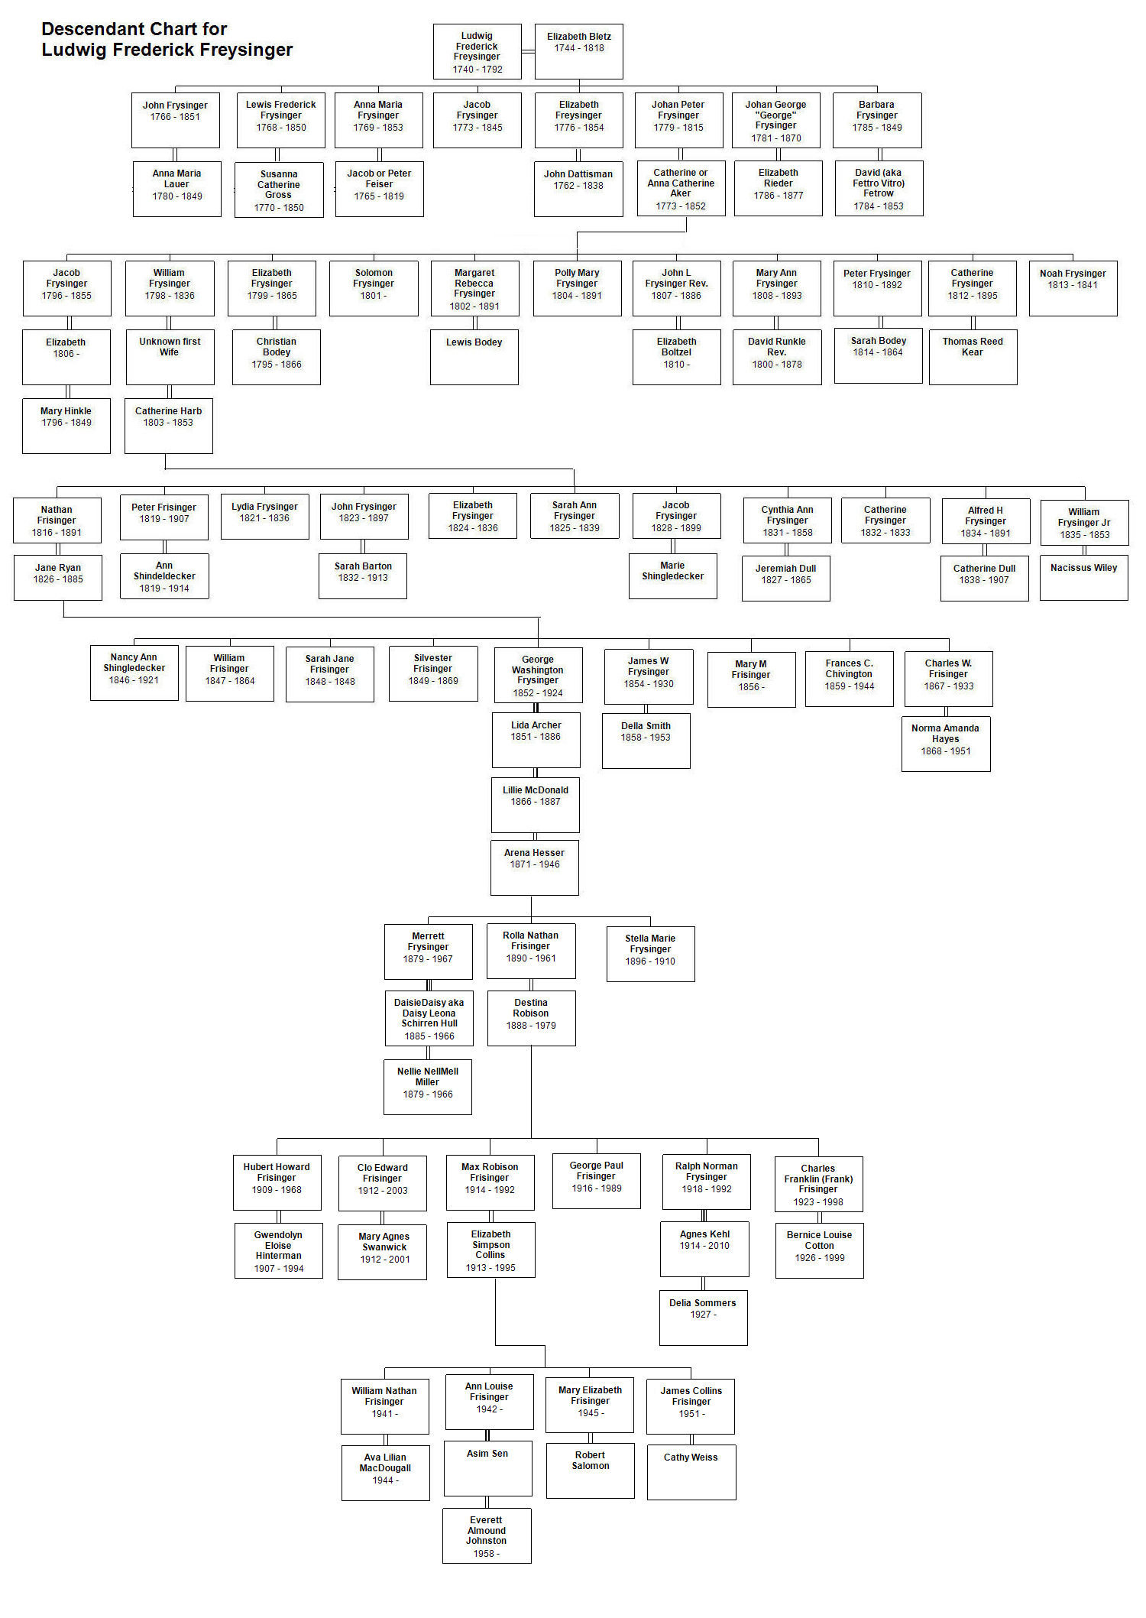
So what is the connection between me and Ludwig?
Slide 34

Slide 35
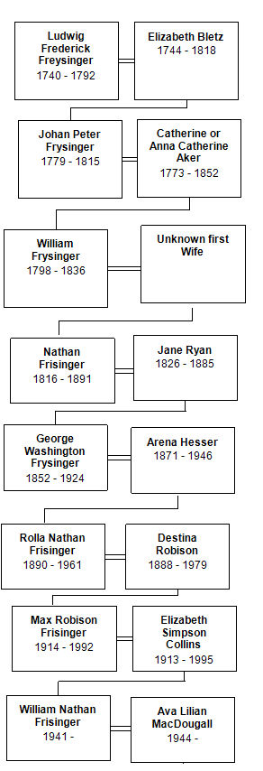
Or excluding other offspring and other wives, the chart becomes much simpler.
Slide 35

