Slide 1
The Diary of Sarah Pearson a Brief Overview
Sarah Pearson was the sister of my maternal Grandmother's paternal grandfather
Her husband Robert Pearson was caption of the Rose Standish, a three misted square rigger that carried freight from ports on the east coast to far flung corners of the world
Sara accompanied him on 3 voyages and kept a journal beginning in 1850
Slide 1

Slide 2
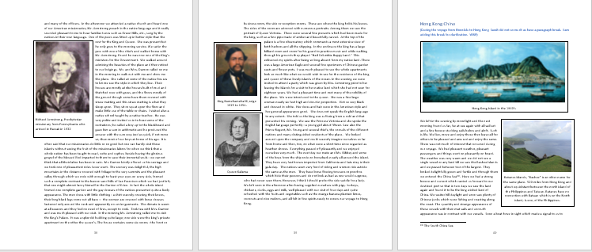
Sample Pages
Slide 2

Slide 3
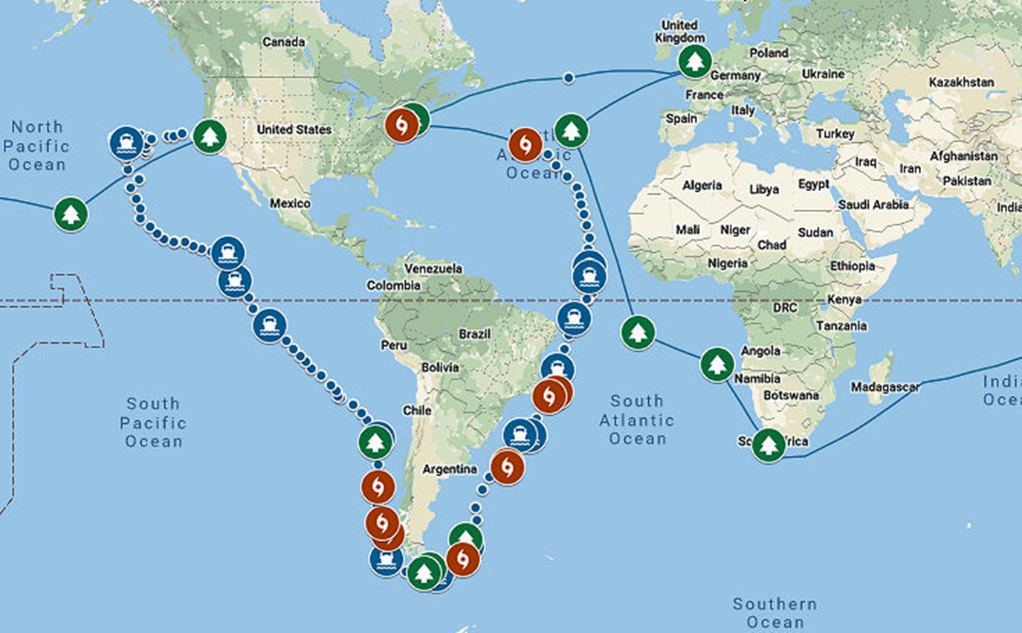
1st Journey Feb. 1850 to Aug. 1851
Around the World
Slide 3

Slide 4
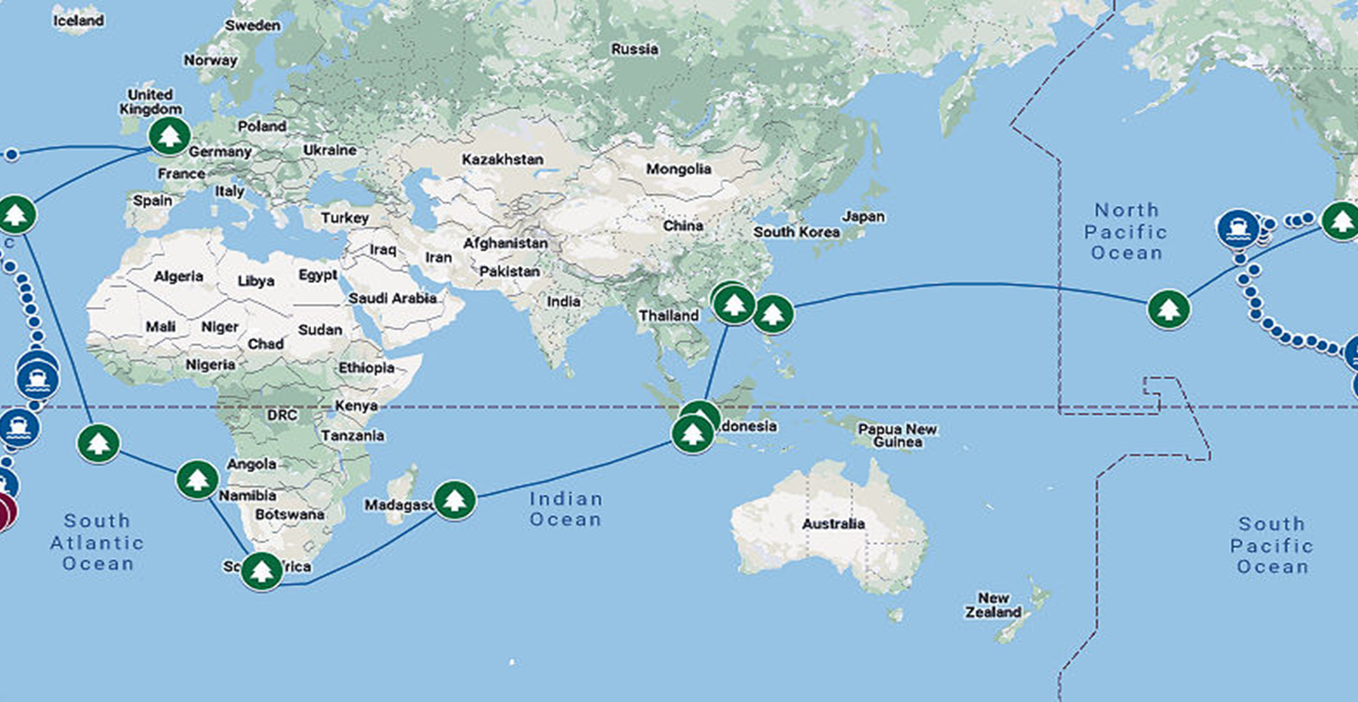
1st Journey, Pacific View
Slide 4

Slide 5
Highlights
February 28th Left New York
March 29th Crossed the Equator
May 10th Rounded South America
August 5th – November 1st San Francisco
November 15 Honolulu
January 1st 1851 Canton China, now Guangzhou, Picked up Charley
Mid April Rounded Africa
June 15th London
August 11th Arrived New York
Slide 5

Slide 6
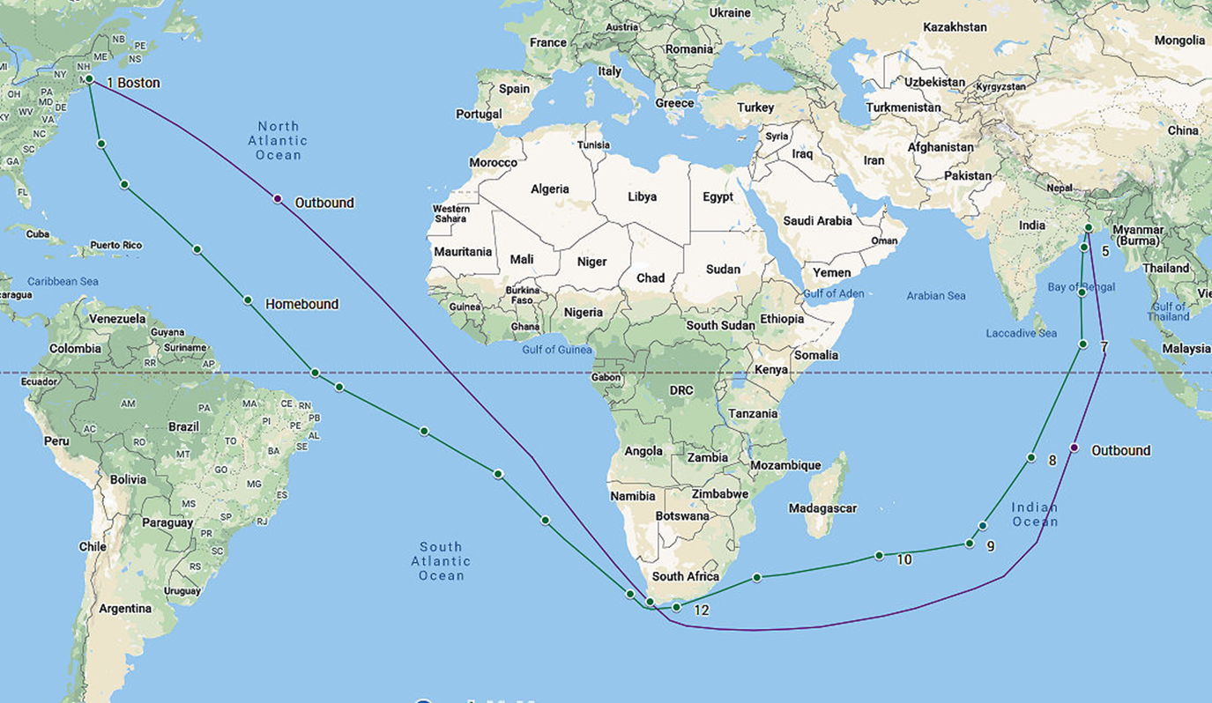
2nd Journey Aug. 1852 to Jul. 1853 to Calcutta India
Slide 6

Slide 7
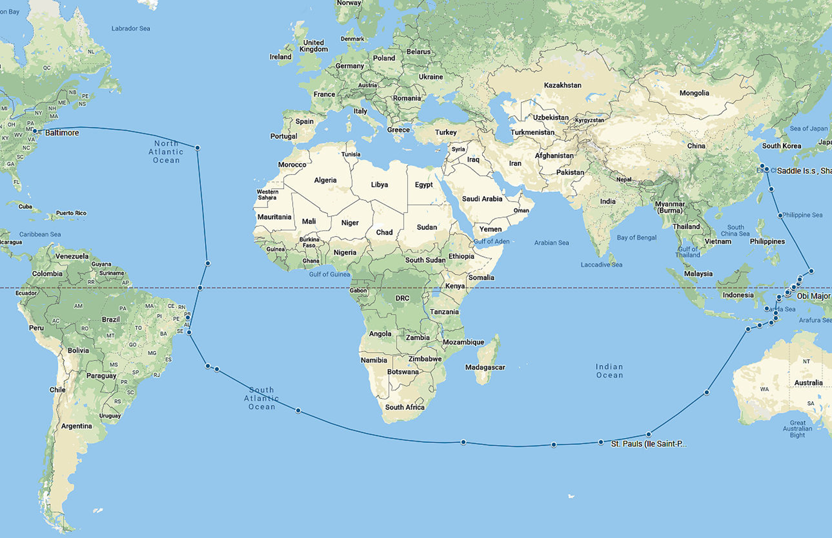
3rd Journey Departing Sept. 1853 for Shanghai China
Slide 7

Slide 8
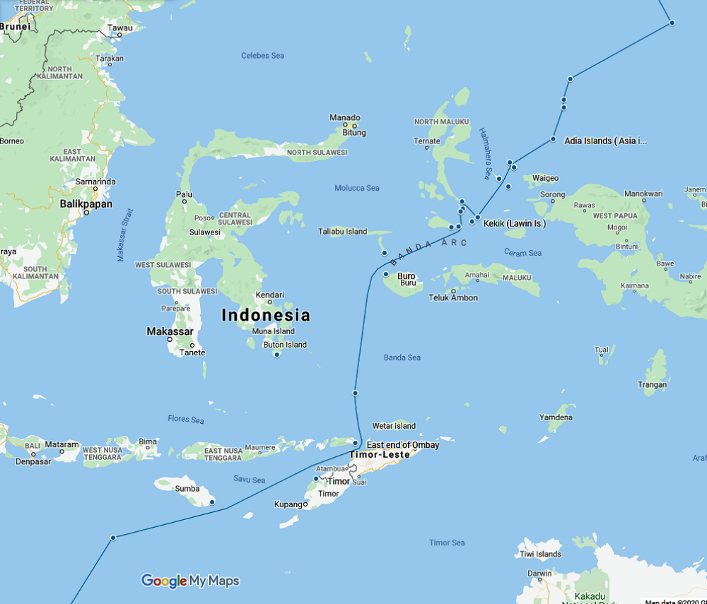
Detail of the passage through the Dutch East Indies
Slide 8

Slide 9
Death of Capt. Robert Pearson
April 15th 1854 Capt. Robert Pearson died of wounds received 11 days earlier in a skirmish with local Chinese
3 other foreigners and many Chinese also died
Sarah ends her journal with this event
Slide 9

Slide 10
Some of Sarah’s Closing Remarks
How frail is human life, short and brittle the thread of human existence. One hour before he was sitting by my side and not one thought ever crossed my breast that he would be taken from me, but God saw best in his infinite wisdom to take him from me and leave me a desolate mourner many, many miles from home, in a land of strangers. But as my dear husband said to me the day before he died, God will take care of you Sarah and He has.
Slide 10

